Slide 1
Improving Land Surface Temperature Estimates in Dust-Contaminated Atmospheres
Francesco Stante
PhD student at Faculty of Sciences of the University of Lisbon
Advisors: Sofia Ermida (IPMA), Isabel Trigo (IPMA), Carlos da Camara (IDL), & Glynn Hulley (JPL)
ESA CCI LST User Workshop, 5/6 Dec 2024

Slide 2
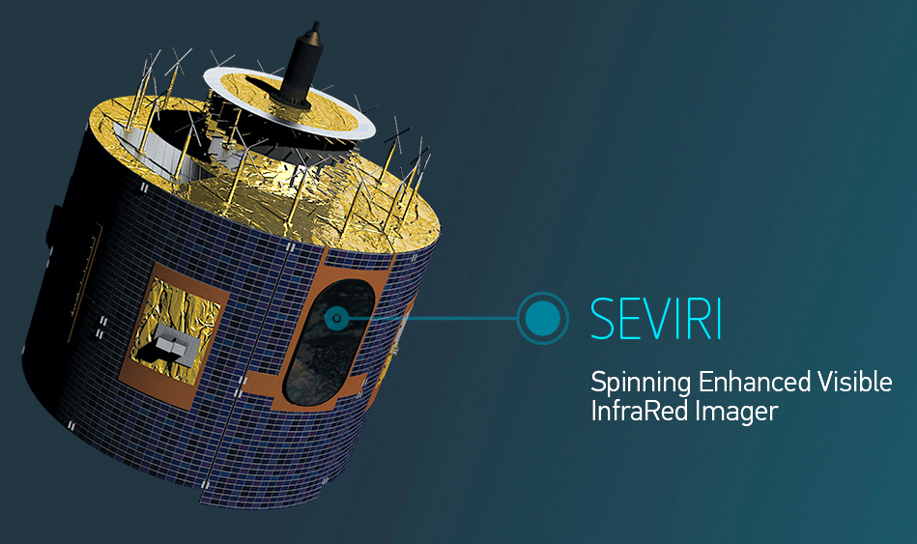
Land Surface Temperature (LST)
Comparing LSASAF LST against ERA5 skin temperature (SKT)
LST Delta [K]: LST – SKT
seasonal means
2009 to 2012
LSA-SAF LST (clear-sky) at 2017-06-15 07:00 UTC
LST estimated using TOA brightness temperatures (BTs) of SEVIRI channels 10.8 & 12.0 µm (TIR)
GSW (Generalized Split-Window) algorithm
$$LST=\left(A_{1}+A_{2}\frac{1−ε}{ε}+A_{3}\frac{Δε}{ε^{2}}\right)\frac{{BT}_{10.8}+{BT}_{12.0}}{2}+\left(B_{1}+B_{2}\frac{1−ε}{ε}+B_{3}\frac{Δε}{ε^{2}}\right)\frac{{BT}_{10.8}−{BT}_{12.0}}{2}+C+ε$$
Meteosat Second Generation (MSG)
$A_{i},B_{i},C$: GSW coefs. calibrated on synthetic data, varying with TCWV and VZA classes
$ε$, $Δε$: average & difference of emissivities; $ε$: error
Notes:
Util para avaliar a perfromance da lst,

Slide 3
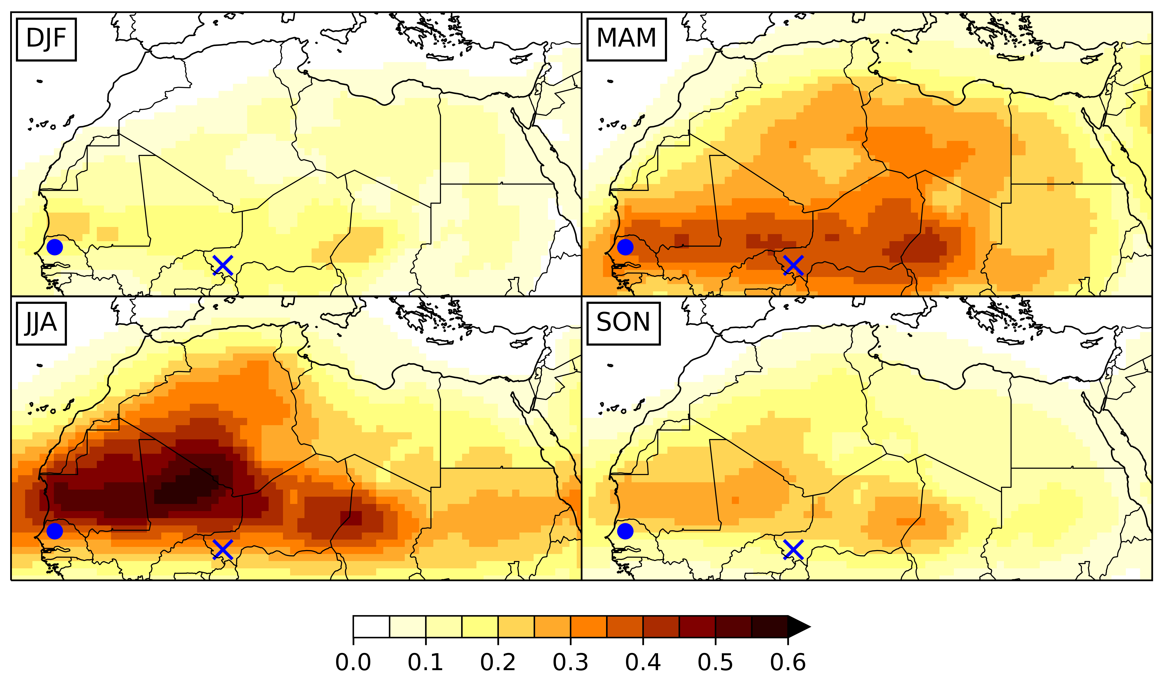
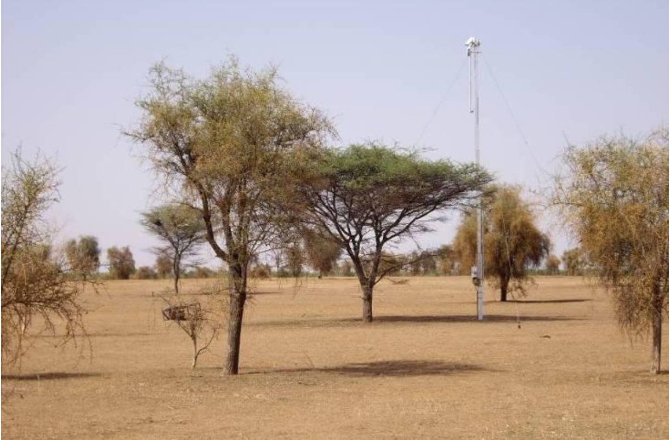
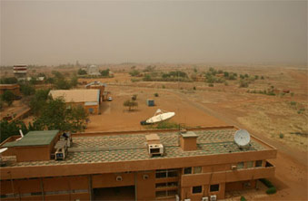
In situ LST comparisons
CAMS EAC4 Dust Aerosol Optical Depth at 550nm (DuAOD)
Dahra: 2009-2012
–0.9 K / 0.1 DuAOD
Niamey: 2006
Dahra, Senegal
Niamey, Niger
LST Delta = MSG LST – ERA5 SKT [K]
Sahara region: 2009-2012
Day
Night

Slide 4
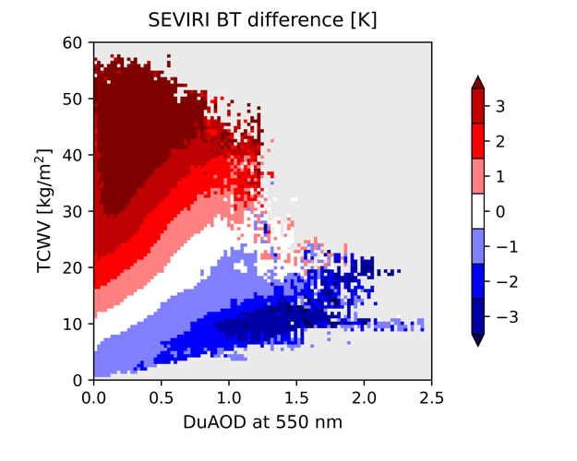
DuAOD-dependent GSW
Calibration
Prescribed variables from ERA5, EAC4, LSASAF:
- surface: SKT, $ε$
- atmosphere: t, q, aermr
- VZA
GSW algorithm:
simulate TOA BTs using RTTOV
$$LST=\left(A_{1}+A_{2}\frac{1−ε}{ε}+A_{3}\frac{Δε}{ε^{2}}\right)\frac{{BT}_{10.8}+{BT}_{12.0}}{2}+\left(B_{1}+B_{2}\frac{1−ε}{ε}+B_{3}\frac{Δε}{ε^{2}}\right)\frac{{BT}_{10.8}−{BT}_{12.0}}{2}+C$$
validate retrieved LST against prescribed SKT with remaining 2/3 of data
calibrate GSW coefs for classes of TCWV, VZA, DuAOD using 1/3 of data
$A_{i},B_{i},C$: GSW coefs. calibrated on synthetic data, varying with TCWV and VZA classes
$ε$, $Δε$: average & difference of emissivities;

Slide 5
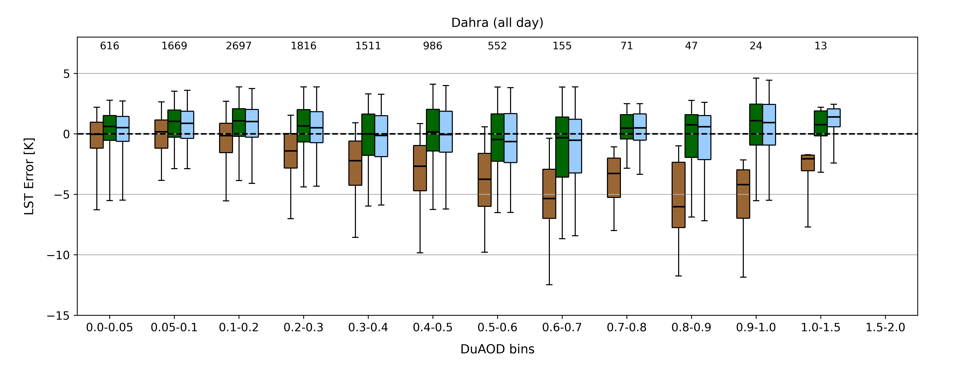
In situ validation
Dahra station (all day)
LSASAF LST
DuAOD-dependent GSW
3-channel DuAOD-dependent GSW
3-channel GSW:
$$LST=\left(A_{1}+A_{2}\frac{1−ε}{ε}+A_{3}\frac{Δε}{ε^{2}}\right)\frac{{BT}_{10.8}+{BT}_{12.0}}{2}$$
$$+\left(B_{1}+B_{2}\frac{1−ε}{ε}+B_{3}\frac{Δε}{ε^{2}}\right)\frac{{BT}_{10.8}−{BT}_{12.0}}{2}+C$$
$$+\left(D_{1}+D_{2}\frac{1−ε′}{ε^{′}}+D_{3}\frac{Δε^{′}}{{ε^{′}}^{2}}\right)\frac{{BT}_{10.8}−{BT}_{8.7}}{2}$$
$ε$, $Δε$: average & difference of resp. emissivities

Slide 6
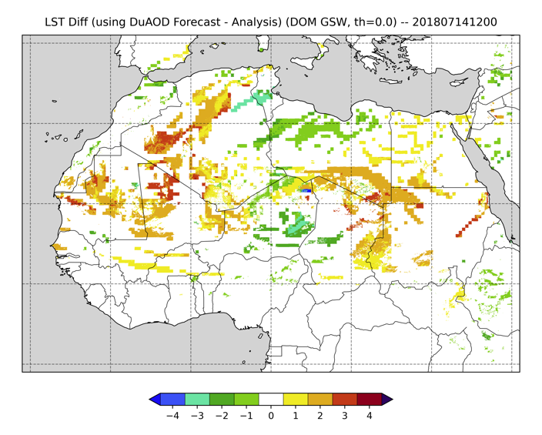
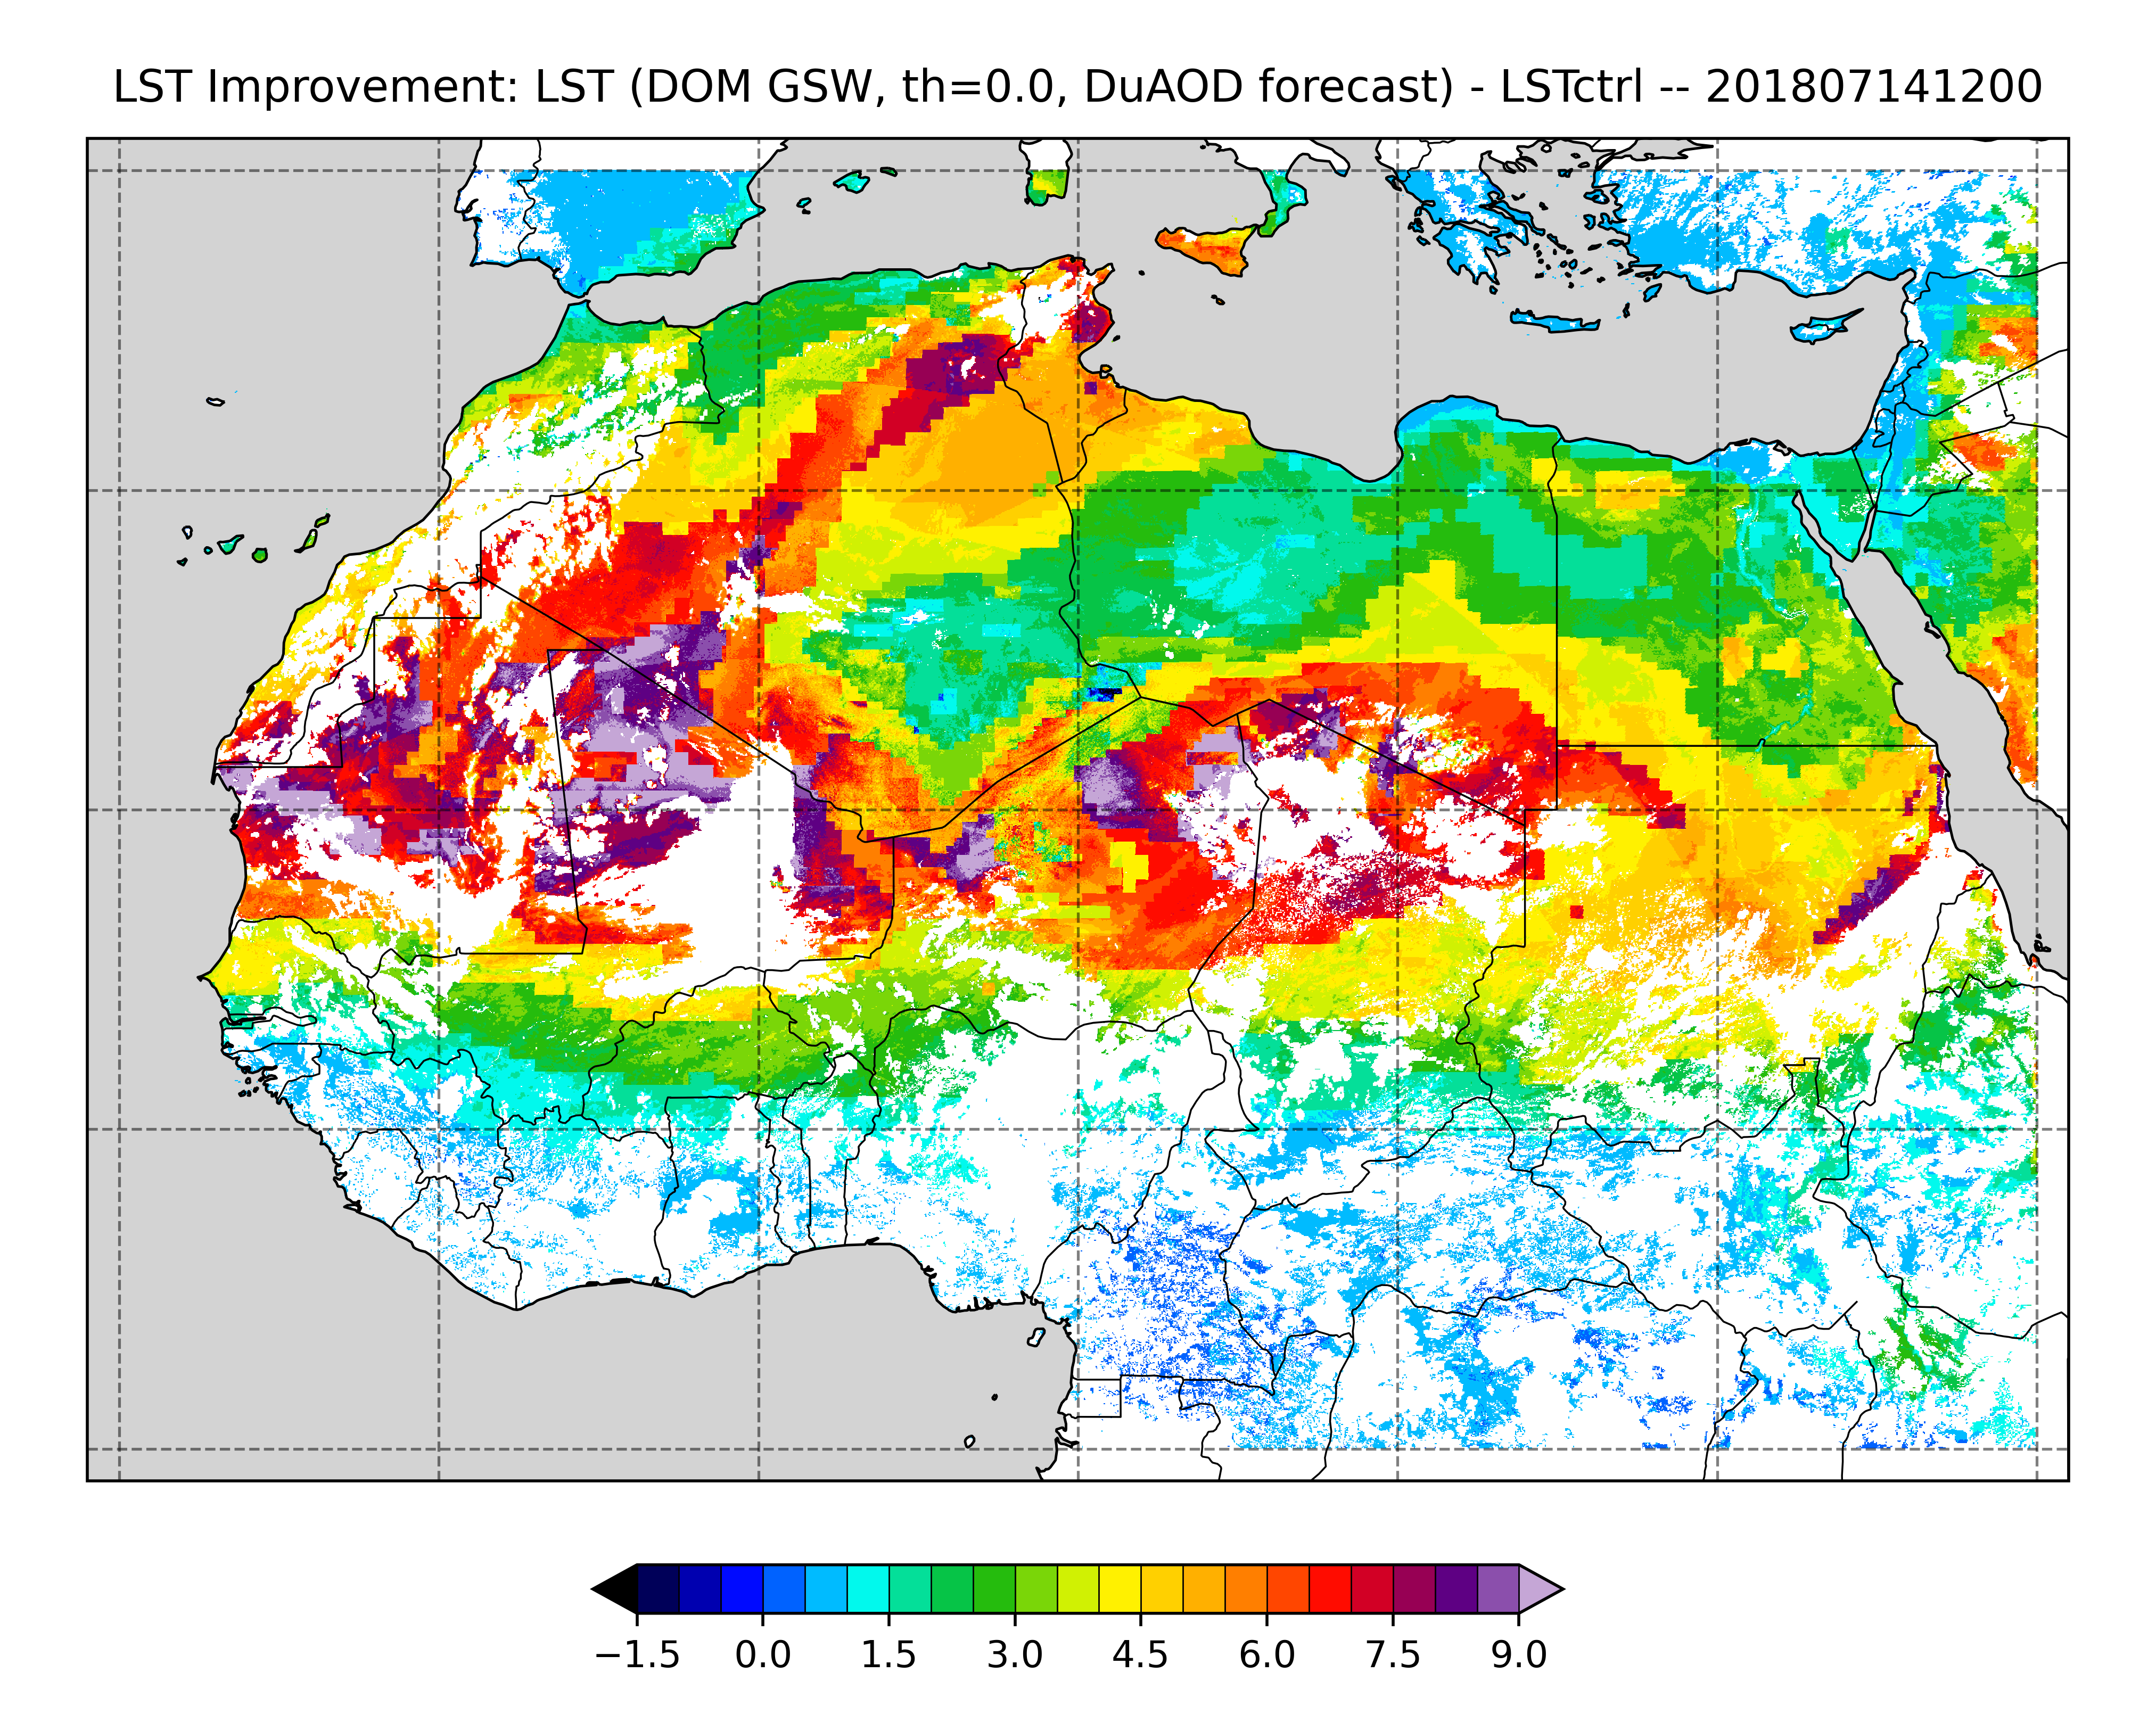
Uncertainties of DuAOD products
Significant errors in LST correction if DuAOD is incorrect
Potential improvement in LST is encouraging, but accurate DuAOD product required

Slide 7
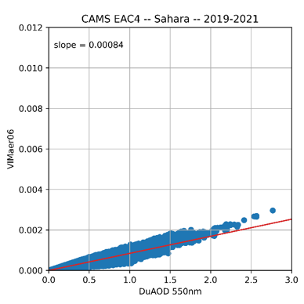
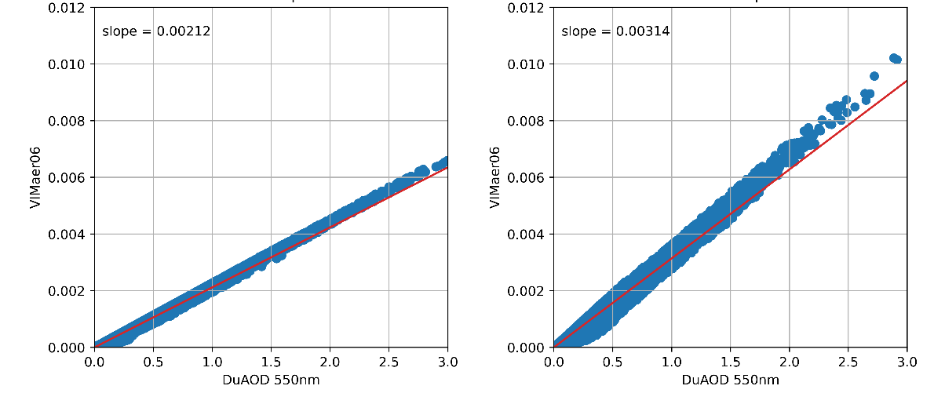
Uncertainties of DuAOD products
CAMS forecast models
Impact of IFS cycle 48r1 (2023)
CAMS EAC4 reanalysis
before 2019
after 2019
m = 0.0008
m = 0.002
m = 0.003
VIMaer06 [kg/m2]
VIMaer06 [kg/m2]
VIMaer06 [kg/m2]
Adapted from CAMS June 2023 upgrade verification note
[K]

Slide 8
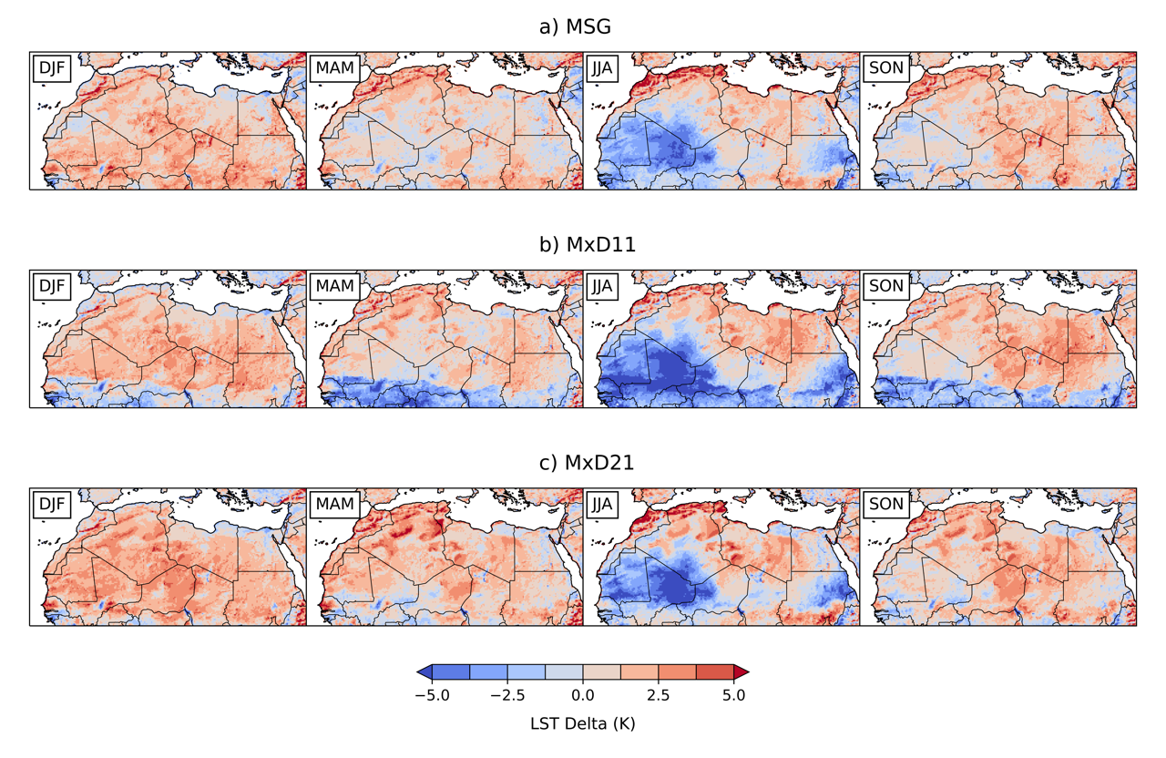
Effect of dust on MODIS LST products
LSASAF
MxD11 (GSW)
MxD21 (TES)

