Slide 1
CMUG interaction
Annett Bartsch (b.geos), Tazio Strozzi (Gamma Remote Sensing), Sebastian Westermann (UIO), Heidrun Matthes (AWI)

Slide 2
Climate Research Group
AWI Atmospheric Physics & Periglacial Research Group
  HIRHAM5-CLM, WCRP CORDEX, Permafrost Carbon Network, GTOS-TOPC
  HORIZON2020 Nunataryuk (involves MPI for climate modelling)
International Permafrost Association (IPA) & GTN-P, including action groups on
  permafrost mapping and
  rock glacier monitoring (incl. Univ. Fribourg, Gamma & UIO)
A Visiting Scientist Program will be established in order to engage relevant user organisations within Europe and especially outside

Slide 3
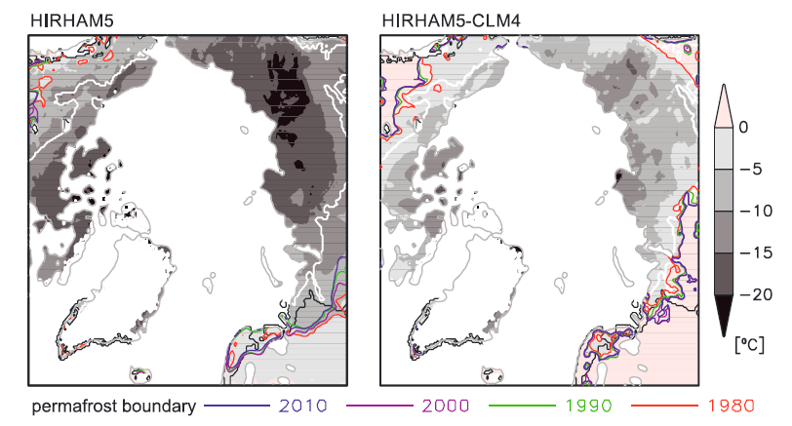
How will the CRG use the proposed products in their applications?
Model comparison with Brown et al. 1997 permafrost zones (white line- continuous permafrost zone, black line – discontinuous permafrost zone) by Matthes et al. 2017.
Soil temperature initialization fields of (left) HIRHAM5 and (right) HIRHAM5-CLM4 represented by the mean January 1979 soil temperature (grey shading). Soil temperatures above 0°C are shaded in pink. Coloured lines indicate the permafrost boundaries computed from modelled soil temperature for the start of each decade covered by the model runs.

Slide 4
Product specifications development
How will the CRGs use the proposed products in their applications?
Model comparison with Brown et al. 1997 permafrost zones (white line- continuous permafrost zone, black line – discontinuous permafrost zone) by Matthes et al. 2017.
Or
with actual temperatures at points/borehole site scale (Chadburn et al. 2017, Biogeosciences)
Permafrost fraction in transition zones based on landcover (peatland) (Chadburn et al. 2017, Nature Climate Change)
Soil temperature initialization fields of (left) HIRHAM5 and (right) HIRHAM5-CLM4 represented by the mean January 1979 soil temperature (grey shading). Soil temperatures above 0°C are shaded in pink. Coloured lines indicate the permafrost boundaries computed from modelled soil temperature for the start of each decade covered by the model runs.

Slide 5
Product specifications development
How will the CRGs use the proposed products in their applications?
Model comparison with Brown et al. 1997 permafrost zones (white line- continuous permafrost zone, black line – discontinuous permafrost zone) by Matthes et al. 2017.
Or
with actual temperatures at points/borehole site scale (Chadburn et al. 2017, Biogeosciences)
Permafrost fraction in transition zones based on landcover (peatland) (Chadburn et al. 2017, Nature Climate Change)
Ground temperatures needed
Soil temperature initialization fields of (left) HIRHAM5 and (right) HIRHAM5-CLM4 represented by the mean January 1979 soil temperature (grey shading). Soil temperatures above 0°C are shaded in pink. Coloured lines indicate the permafrost boundaries computed from modelled soil temperature for the start of each decade covered by the model runs.

Slide 6
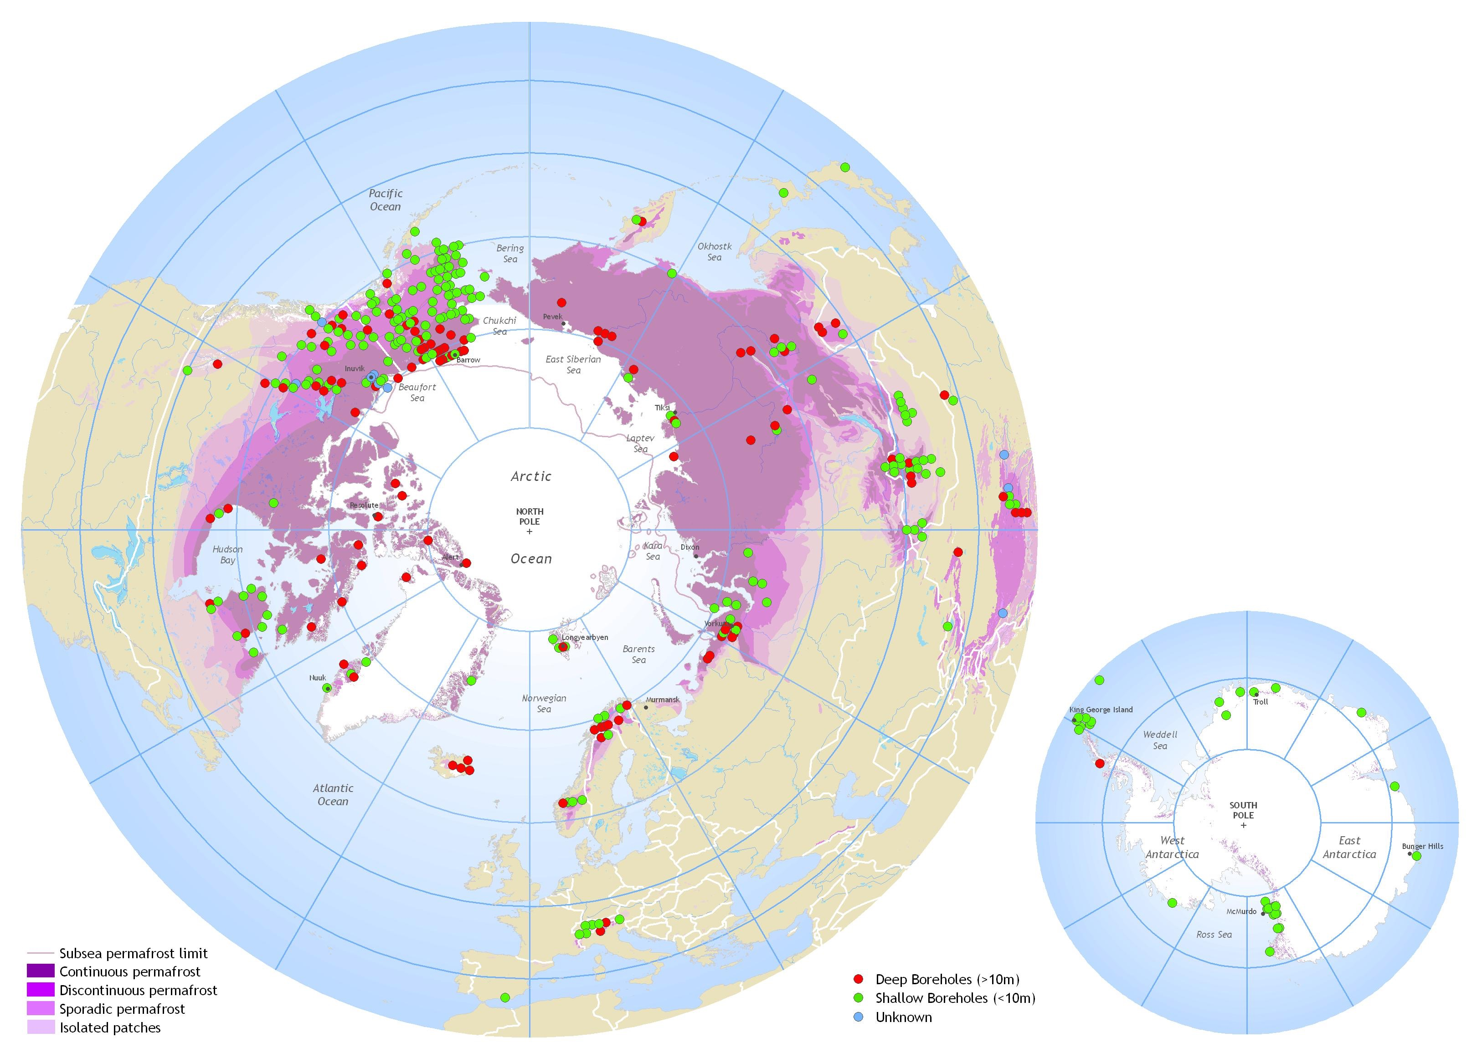
User Requirements
Permafrost_cci addresses the parameters as required by GCOS (T33) as well as the CRG
  Permafrost temperature (K)
  Depth of active layer (m) -> seasonal soil freeze/thaw (T34) in permafrost regions
A permafrost parameter not considered yet in GCOS is rock glacier velocity, but essential according to members of the IPA

Slide 7
User Requirements
Permafrost_cci addresses the parameters as required by GCOS (T33) as well as the CRG
  Permafrost temperature (K)
  Depth of active layer (m) -> seasonal soil freeze/thaw (T34) in permafrost regions
Sources for specifications
  User requirements for permafrost are available from several community documents
    White paper in response to the WMO Polar Space Task Group 2014
    National Research Council workshop report 2014
    General survey + Interviews with climate modellers in GlobPermafrost, documented in respective URD
  In addition online survey targeting climate modelling, sources will be documented in the URD
tracible

Slide 8
User Requirements
CMUG needs for
  Depth of active layer (m) and
  Permafrost temperature (K).
Fill in survey by 10th of November
Link on permafrost_cci webpage

Slide 9
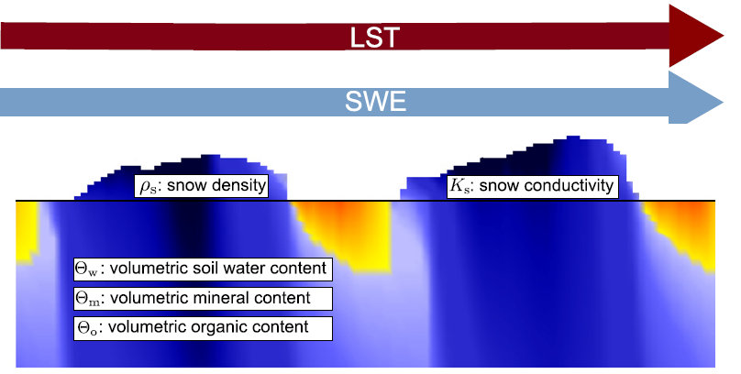
Consistency between the ECVs
Permafrost_cci will consider the use of
  Landsurface temperature – will be combined with re-analyses data
  Snow extent
  Landcover – masking of lakes (+ glaciers?) and snow distribution parameterization, ideally also soil parameterization (peatlands).
  Glaciers, Ice sheets – alternative for masking of ice sheets and glaciers
  Soil moisture and SWE – too coarse, not applicable in lowland pemafrost areas and mountains respectively
Quality assessment before use
Participation in user workshops

Slide 10
Feedback to CMUG
Passive monitoring of Permafrost study should be revised as it assumes that SM is used
SM from CCI is not used in Permafrost modelling (due to e.g. high water fraction in the Arctic, limitations in high mountain regions)
SM utility is evaluated in the context of soil parameterization

Slide 11
How will the CRGs use the proposed products in their applications?
Evaluation and assessment of Team Climate Models (Section Atmospheric Physics at AWI Climate Science; University of Exeter). ESMValTool will be tested for the regional model HIRHAM-CLM.
Initialization of Team Climate Models using the CCI Permafrost Extent Product and investigation of resulting impacts on atmosphere physics and dynamics (Section Atmospheric Physics at AWI Climate Science)
Evaluation and validation of MAGT in the CCI Permafrost Extent Product and in simulations from Team Climate Models adapting GTN-P ground data (Section Atmospheric Physics at AWI Climate Science, GTN-P office).
The Global Land Modelling Community through the Modelling Working Group of Permafrost Carbon Network aims to provide synthesized data for assimilation and initialization by biospheric and climate models contributing to IPCC6

Slide 12
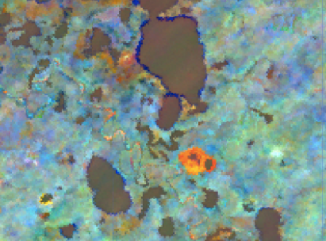

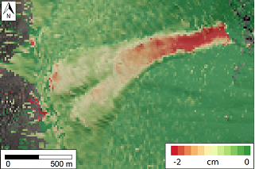
How will the CRGs use the proposed products in their applications?
Linkage with surface indicators in permafrost regions – lowlands, mountains and coasts
  Assessment of linkages between carbon pools, land surface changes, and permafrost using other satellite products, specifically from Globpermafrost (AWI GeoScience).
  validation and assessment for mountain permafrost regions with in-situ observations of ground temperatures, changes in subsurface ice and unfrozen water content and velocities of permafrost creep from PERMOS and satellite derived rock glaciers inventories as well as trends from GlobPermafrost and Options.
  Evaluation of Arctic climate change in coastal permafrost regions, specifically coastal erosion (HORIZON2020 Nunataryuk, includes climate modelling)

Slide 13
Product specifications development
Currently no threshold & target requirements endorsed by the CRG exist
  Permafrost_cci needs to initialize its formulation
Round robin setup considers previous focus areas of CRG members, with benchmarking datasets (however no suitable benchmark dataset exists from perspective of members of the IPA)
  Permafrost_cci needs to support the implementation of guidelines by expressing the need and fostering the process of standardization
access to soil parameterization will be provided to the CRG

Slide 14
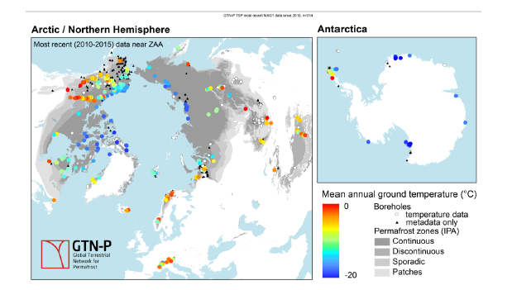
Product uncertainty
integrated approach for the Validation and the Climate Science Assessment of the
CCI+ Permafrost product by liaising
  with the provider of validation data and ground data standardization initiatives (IPA and GTN-P)
  with the CMUG and the model climate science group to coordinate comparison, assessments and initialization experiments.
validation will be performed point-wise (borehole or soil temperature profile per standardised depth will provide average bias and RMSE), grid-wise (permafrost maps and geophysical transects) and functional (LC class specific relative errors per pixel)
Notes:
Metrics
for validation will be defined in discussion with the mapping group [

Slide 15
What data are we producing, and when?
Permafrost Temperature
Active Layer Thickness
Epochs according to SoW: 1997, 2007, 2017
In year 1 (May 2019), model runs for the period 2003-2017 will be performed, so that preliminary data will already be available for the first two epochs
In year 2 (May 2020), the modelled period will be extended to 1980-2018, so that all epochs are covered by a single model run with sufficient spin-up time in a single consistent run.

Slide 16
Data needs for ECMWF reanalysis data
ERA-5 data 1980 (2000) – now
Phase 1
Surface fields: air T, precipitation, orography, (wind speed?)
Pl700, Pl500, Pl300: air T, elevation
In addition in Phase 2+
Surface fields: LW_in, SW_in, wind speed, T_dew, sublimation
Pl700, Pl500, Pl300: wind speed, T_dew

Slide 17
Complementary with CMUG research
Focus on permafrost
To be completed after Monday

Slide 18
CCI-relevant meetings
2018
  CCI snow user workshop, CCI soil moisture user workshop
  AGU
    Information event (facilitated by ARCUS) jointly with GlobPermafrost
    Annual meeting of the Permafrost Carbon Network
2019
  EGU -> session organized on Permafrost
  Living Planet Symposium -> session organized on Permafrost
  ASSW 2019 (Arctic Science Summit Week) in May; SouthCOP in December
  REKLIM conf. in Berlin in combination with user workshop;
  Polar CORDEX
CCI LST user workshop?
Notes:
The Arctic Research consortium of the US

